Slide 1
CS398 Mini Project

Slide 2
Outline
Problem Statement
Checkers
Board Representation
Minimax Algorithm
ɑꞵ-pruning
CPU Implementation
PV-S
CUDA Implementation
Hypothesis
Testing
Findings
Conclusion

Slide 3
Problem Statement
For zero-sum games, a game tree is implemented to approximate the possible move for the computer player. Given a zero-sum game (Checkers), will the use of CUDA provide improvements to efficiency with regards to the decision tree searching?

Slide 4
Checkers
Two players
Black pieces and white pieces with all pieces on black cells
Pieces can only move diagonally
Normal piece can only move forward and only backward if they become king upon reaching the opponent side
Objective of the game is to capture all of the opponent pieces

Slide 5
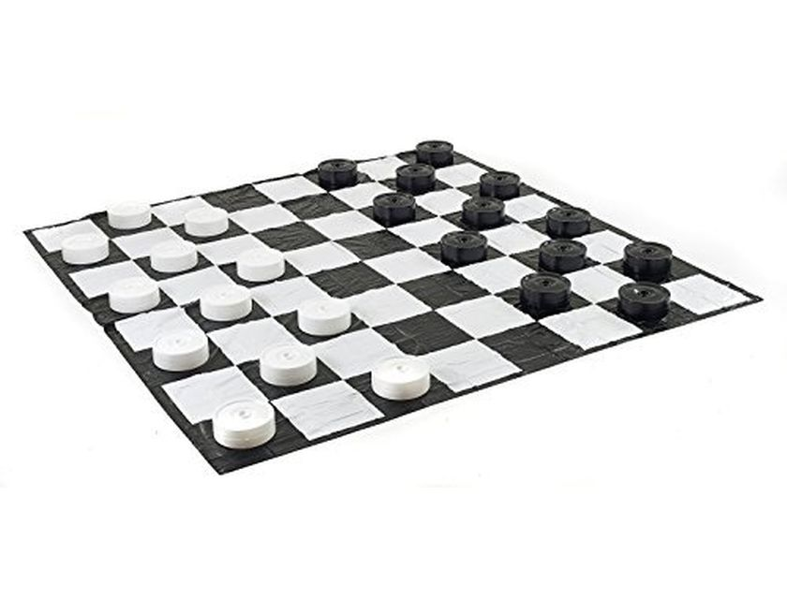
Checker board in real life

Slide 6
Board Representation
Array representation
Each element represents a cell on the board
Element must contain information needed by a checker piece
Colour
King status
Naive representation requires at least 2 data members of at least 1 byte each, for spread across valid cells
Can potentially be bigger depending on the data type used
Space complexity O(n²)
Moves evaluation
Array traversal

Slide 7
Board Representation
Space Constraints
If each cell is 2 bytes big, then space requirement will be 2xnxn bytes
8x8 board - 2x8x8 = 128 bytes
Data Locality
Can potentially be a performance issue depending on the data type used for the internal data
Can cause performance issue when board size increases

Slide 8
Board Representation
Bit-board alternative
Represent each cell with 1 byte
Ignore cells that cannot contain pieces
8x8 board has 4x8 valid cells
32-bits needed i.e. 4 bytes
Need to keep track of cell state
Use 3 values of 32-bits to represent white, black and kings
Entire board can be represented using very little space
E.g. 8x8 board will only need 12 bytes to store the entire board
Moves evaluation can be done using bit-wise operations
More complex in implementation, but is efficient

Slide 9
Board Representation
Implementation constraints
Data structure must be re-implemented based on size (not flexible)
Not all board sizes can be implemented efficiently using the bit board representation

Slide 10
Board Representation
Our choice - bit boards
Game tree search can potentially generate huge amount of moves, which must be represented by either a second movement structure or a copy of the board state
Small memory footprint means the entire bit board can be used as-is as a movement representation as well
Moves generations is efficient as simple bit-wise operations will generate all possible moves with very little operations

Slide 11
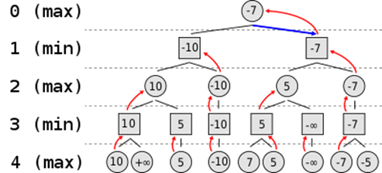
Minimax Algorithm
Game tree implementation
Utility optimisation
Player will try to maximise utility expecting the opponent to pick a move that minimises its utility

Slide 12
ɑꞵ-pruning
Optimization process that “prunes” branches of the decision tree
Uses ɑꞵ values that are updated based on the node type (min/max) of the current node being searched
Makes Minimax more efficient by prematurely end the search of child nodes when no more optimal results are expected for the current node

Slide 13
CPU Implementation
Extraction of possible moves using bitwise operation
Sending the possible moves to Next function of minimax with alpha beta pruning
Next will call min function
Min function will call max function
Max function will call min function until min function reaches a terminal value or depth
Max function will get the highest value to start beta pruning and return the v value
Min function will get the alpha value via max function and v value from max function and do its alpha pruning
Once max and min function has performed the pruning and acquired the v values,comparison will be made to get the next best move

Slide 14
CUDA

Slide 15
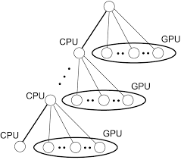
PV-S
It is an algorithm that combines both CPU and GPU together whereas and the
CPU will provide the main left node
Right will be process by GPU.
Rationale:
CPU’s computation of the left node will produce output that will give the GPU information to use for pruning
“Principal Variation-Splitting”

Slide 16
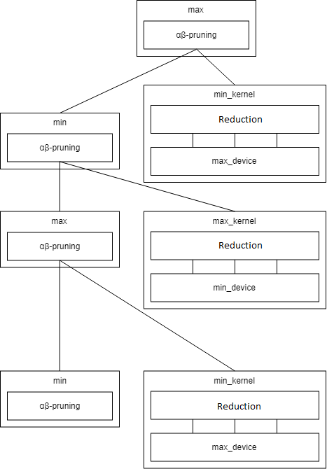
CUDA Implementation
Making use of GPU with PV-S algorithm to process the nodes, as well as the future child nodes until it reaches terminal or desired depth
Make full use of all the threads in a block by making the block expand for extra depth.
Use reduction to perform max/min operation on the computed utilities in parallel

Slide 17
Hypothesis
By implementing of PV-S with CUDA, getting the best decision will be fast.
For higher depths, the GPU will outperform the CPU

Slide 18
Testing
Test the speed by running the same board configuration (i.e. first move is fixed) on both the CPU and GPU
Average time taken for decisions are logged
Both implementations will run separate games with same configuration and have both player turns use AI running minimax to determine decision
Correctness is tested through comparing if both CPU and GPU AIs made the same decisions through the game

Slide 19
Test Types
CPU benchmarking
GPU benchmarking
Given the same board, CPU vs CPU and GPU vs GPU
CPU and GPU play against each other on the same board

Slide 20
Findings
GPU implementation of Minimax did not yield much significant results
CPU is faster than GPU on most instances
GPU has lots of overhead when run
Using bitboard speeds up CPU decision making
GPU doesn’t produce desired results as depth increases
GPU always loses to the CPU when made to play against each other

Slide 21
Conclusion
Using minimax will not yield great results on the GPU while using bitboard maps
Parallel computation on the GPU do not make the memory transfer overhead negligible due to small data size
BitBoard maps caused CPU to have much faster execution that GPU.
Bit boards already make the minimax more efficient, which makes the memory transfer overhead’s effects more obvious on the GPU

